Slide 1


Stochastic and Modeling & Simulation Load Analysis
Electric Power Load Analysis (EPLA)
Revision of 8 June 2026
Dr. Norbert Doerry
http://doerry.org/norbert/MarineElectricalPowerSystems/index.htm
© 2026 by Norbert Doerry
This work is licensed via: CC BY 4.0 (https://creativecommons.org/)

Slide 2
Essential Questions
When should stochastic load analysis or modeling and simulation load analysis be performed? | Understand
How is stochastic load analysis performed? | Understand
How is modeling and simulation load analysis performed? | Understand

Slide 3

Stochastic Load Analysis
Modeling and Simulation Load Analysis
Stochastic Load Analysis
  Model loads as a probability density function (PDF)
  Correlated loads modeled together
  Use Monte Carlo simulation to determine PDF of total load for a particular power distribution equipment.
  Apply margin and Service Life Allowance
Modeling and Simulation Load Analysis
  Model loads as a function of time. May include dependence on random variables and other loads.
  Correlated loads must communicate with each other, but do not need to be modeled together
  Load models can incorporate time of day (meals – watch rotation, etc)
  Use Monte Carlo simulation for random variables
  Calculate time trace of total load
  Apply margin and service life allowance
Interpret results with respect to power distribution system equipment
  Does a particular short term overload of the equipment result in a service interruption.
  Do the service interruptions occur infrequently enough to enable meeting Quality of Service Mean Time Between Service Interruption (MTBSI)
Process defined in DPC 310-1

Slide 4
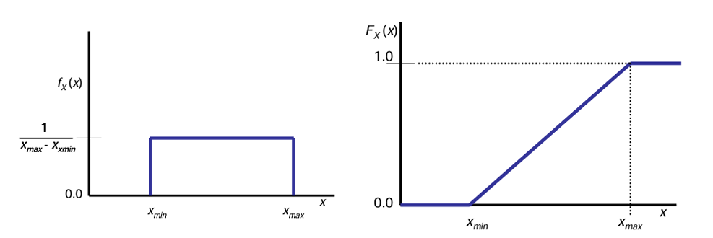
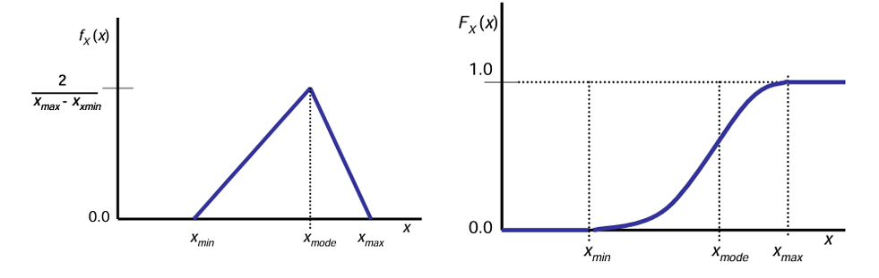
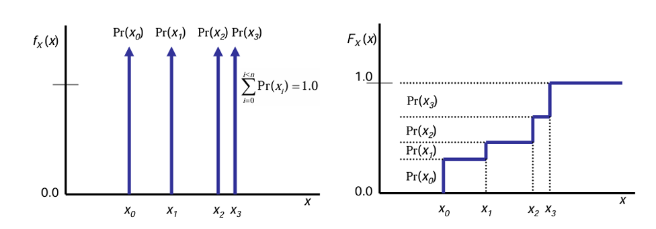
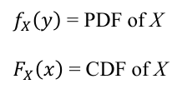
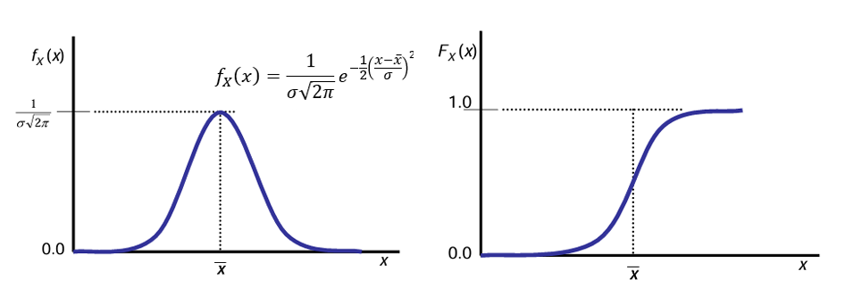

Probability Density Functions (PDF)
Cumulative Distribution Function (CDF)
The integral of a PDF over an interval of x is the probability that the random variable X will fall within the interval.
A CDF is the probability that the random variable X will be less than or equal to x
Uniform Distribution
Triangular Distribution
Discrete Distribution
Normal Distribution
Figures from DPC 310-1

Slide 5
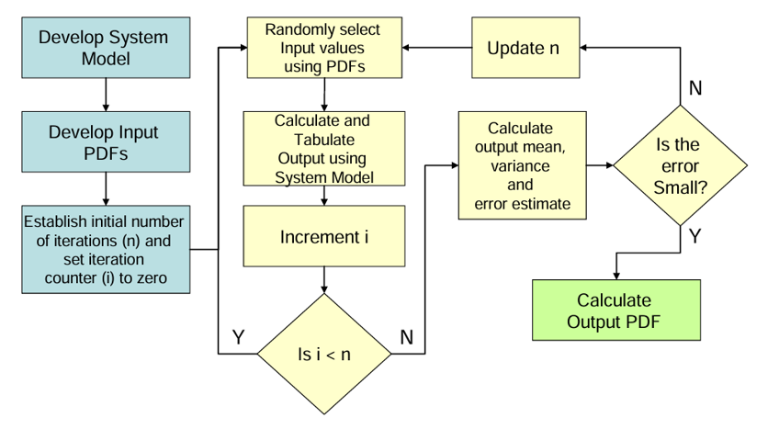
Monte Carlo simulation process
Figure from DPC 310-1

Slide 6
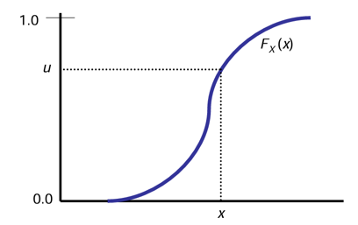

Developing a value of x that adheres to a PDF
Inverse Transform technique
Calculate the CDF from the PDF
Create a sample u from a uniform distribution over the interval [0:1]
Solve the equation for x
x adheres to f_{x}(x)
Figure from DPC 310-1

Slide 7



Iterating in a Monte Carlo simulation
The total load is calculated n times by summing the applicable load values that are sampled from their respective PDFs.
Initially n is set to a value which is believed sufficient to develop good estimates for mean values and standard deviation. Usually a number of about 500 is adequate.
  Mean Value
  Variance and Standard Deviation
Update n based on estimating the error E
  Generally set E to no more than 0.02

Slide 8
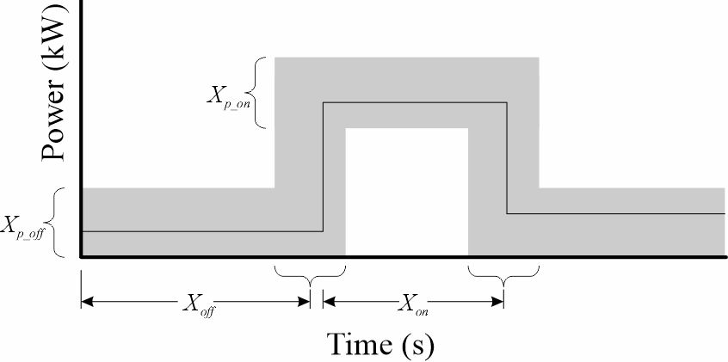
Modeling and simulation load models
For each load, produce a waveform of power as a function of time.
Can be completely deterministic or a function of random variables.
  Can use measured data to calibrate models.
Can depend on other loads or time of day.
Load model that depends on 4 random variables

Slide 9
Modeling and Simulation Analysis
Time Increment
  Generally around 1 second
  In-rush current and transients need not be modelled (model them differently)
Simulation Duration – Equipment Sizing
  Generally should be about 100 times the quality of service metric for Mean Time Between Service Interruption (MTBSI)
    Factor of 10 to limit temporary overloads contribution to MTBSI
    Factor of 10 to develop a reasonable estimate of the number of service interruptions
    Ensembles may be employed to enable parallel processing for increased calculation speed.
  Example
    MTBSI of 30,000 hours implies 10.8 billion seconds should be simulated
Simulation Duration – 24-hour average
  Much shorter times are likely sufficient – 2400 hours should provide a sufficiently accurate mean value estimate.

Slide 10
Results of analyses
Stochastic Analysis
  Probability Density Function of the total load
    Service Life Allowance and Margin applied
  Evaluation of whether exceeding the rated load of the equipment under study will lead to a service interruption.
    Generally, meeting the rated load about 95% of the time is sufficient.
Modeling and Simulation Analysis
  Apply margin and service life allowance
  Evaluation of whether exceeding the rated load of the equipment under study will lead to a service interruption.
  Limiting the contribution to MTBSI to an allocated fraction of the allowed service interruptions.

